Slide 1
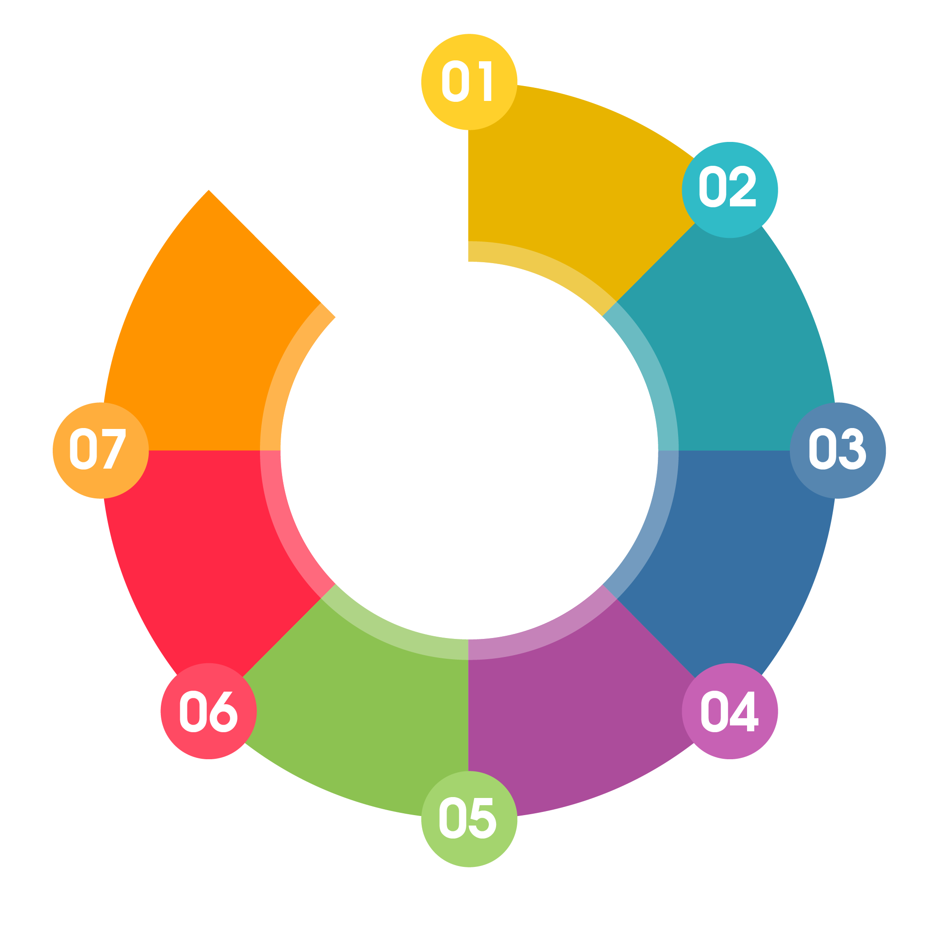



    STUDENTS’ UNIVERSITY OF CHOICE
    FINANCIALLY SUSTAINABLE
UTeM’s Seven (7) Strategic Goals (SSG) 2021-2025
    GRADUATES OF CHOICE
    SOLUTION PROVIDERS FOR
    INDUSTRIAL & SOCIETAL ADVANCEM-ENT
SMART & DYNAMIC CAMPUS
T.U.N.A.I
Technology@University Advancing Industry & Society
    VISIBLE & GLOBALLY PROMINENT
    COMPETENT & ROBUST TALENT

Slide 2

GOAL 7:
FINANCIALLY SUSTAINABLE
NEW MODEL FOR INCOME GENERATION
  70% PTJ : 30% University based on PTJ’s projection.
  Facilitate PTJ through processes and procedures through consistent mitigation plans.

Slide 3
GOAL 7 : Financially Sustainable
Increase income from UHSB Group
Deliverables
Facilitating commercialization of knowledge and ideas among staff
Reduction on cost per student
01
To Increase Income Generation 30% by 2025
(3% income growth annually)
02
07
Goal 7 Strategic Initiatives
02
Strengthening marketing initiatives of crowdfunding, sponsorship, zakat, waqf & endowment through involvement at every level of management
Strengthening asset monetisation and retailing services
03
06
03
06
04
05
04
05
Optimizing UTeM's Operating Expenditure Based On Initial Budget Approval
Strengthening profitable financial activities for higher return investment
Generating income from students fees

